Slide 1
What is a Quasicrystal?
Mathematical Foundations of Quasicrystallography
Alexander Illarionov
6.05.2015

Slide 2
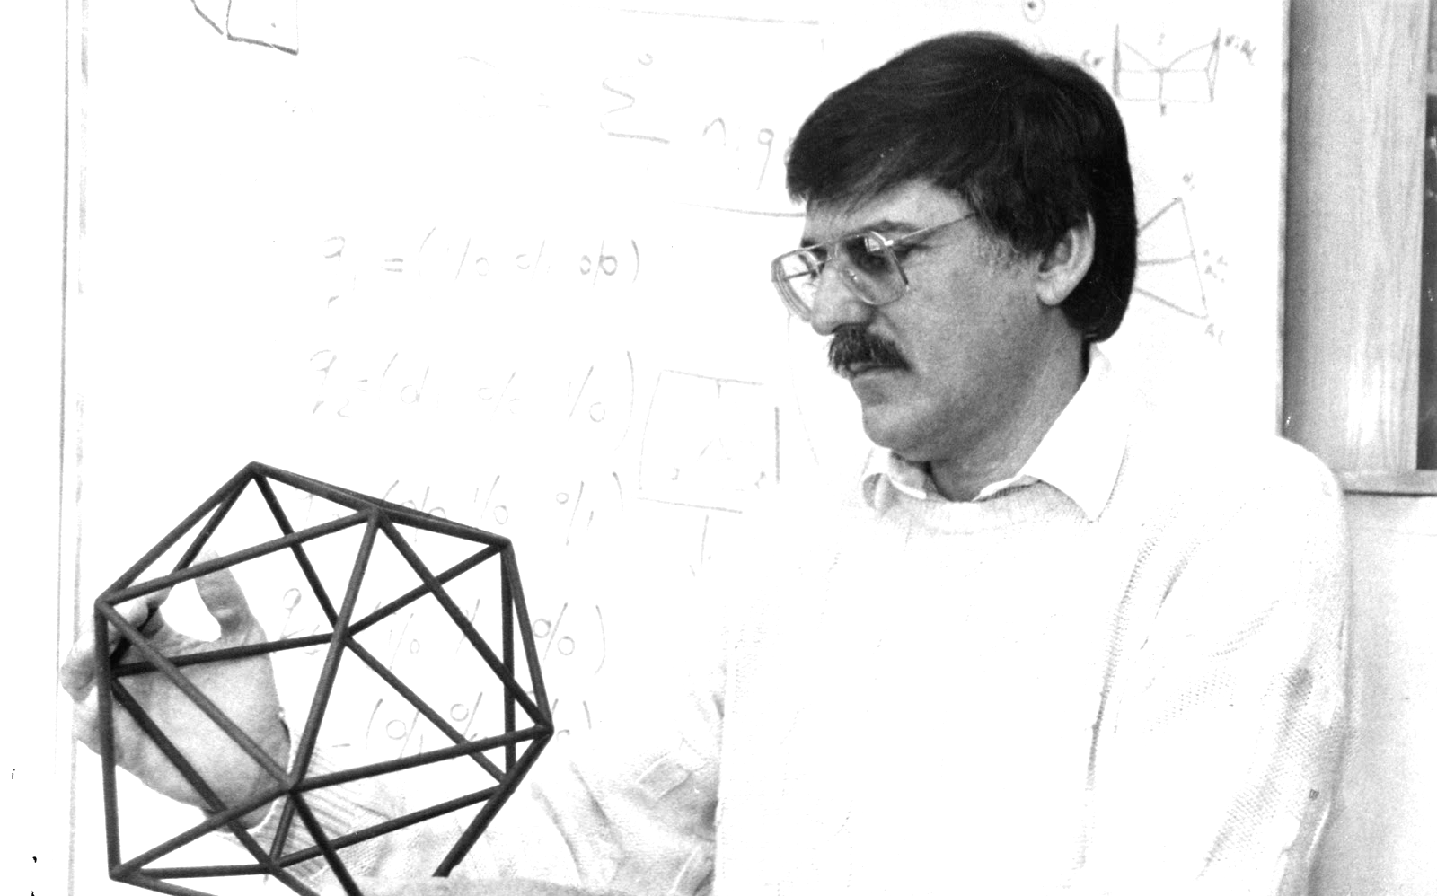
Introduction
Photo Credit: Technion –
Israel Institute of Technology
Until the 1980s, periodicity was the paradigm of crystallography. However, Dan Shechtman’s discovery of a quasicrystalline Al-Mn alloy with ‘forbidden’ rotational symmetry in 1982 proved the necessity of the paradigm shift.

Slide 3
Rotational Symmetry
A point set X is said to possess rotational symmetry
if X is invariant under the group of rotations.
In two and three dimensions, only 2-fold, 3-fold, 4-fold, and
6-fold rotational symmetries exist. These symmetries are called crystallographic.

Slide 4
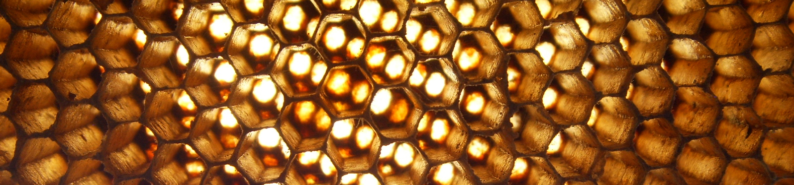
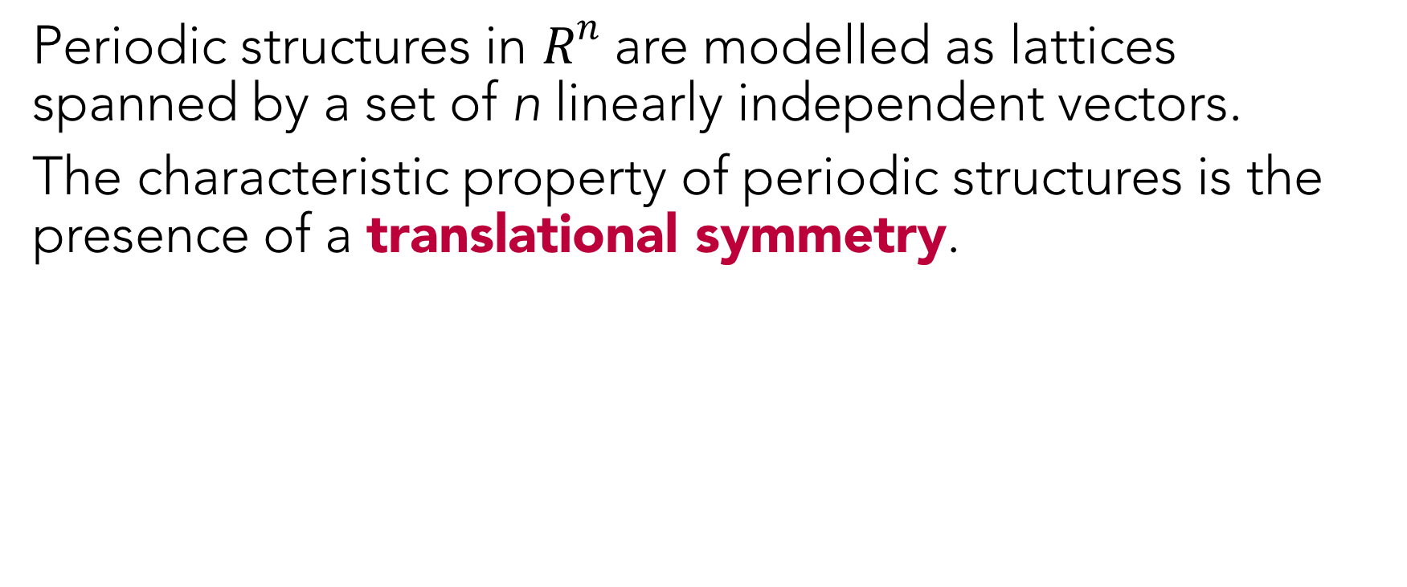
Periodic Structures
Periodic structures in $R^{n}$ are modelled as lattices spanned by a set of n linearly independent vectors.
The characteristic property of periodic structures is the presence of a translational symmetry.

Slide 5
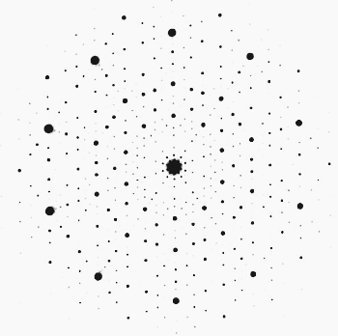
Rotational Symmetry of Periodic Structures
Periodic structures can only possess crystallographic symmetries.
In 1982 Dan Shechtman discovered a rapidly quenched Al-Mn alloy with the icosahedral point group symmetry. The structure of the alloy was ordered and nonperiodic.
Credit: Shechtman et al, “Metallic phase with long-range orientational order and no translational symmetry”

Slide 6
Questions
The term quasicrystal was coined to describe nonperiodic structures with long-range orientational order but lacking translational symmetry.
However, what is a crystal?
And what are quasicrystals and how can they be described?
What is the relation between periodicity and aperiodicity?
What is the general procedure allowing to construct nonperiodic structures with long-range orientational order?

Slide 7
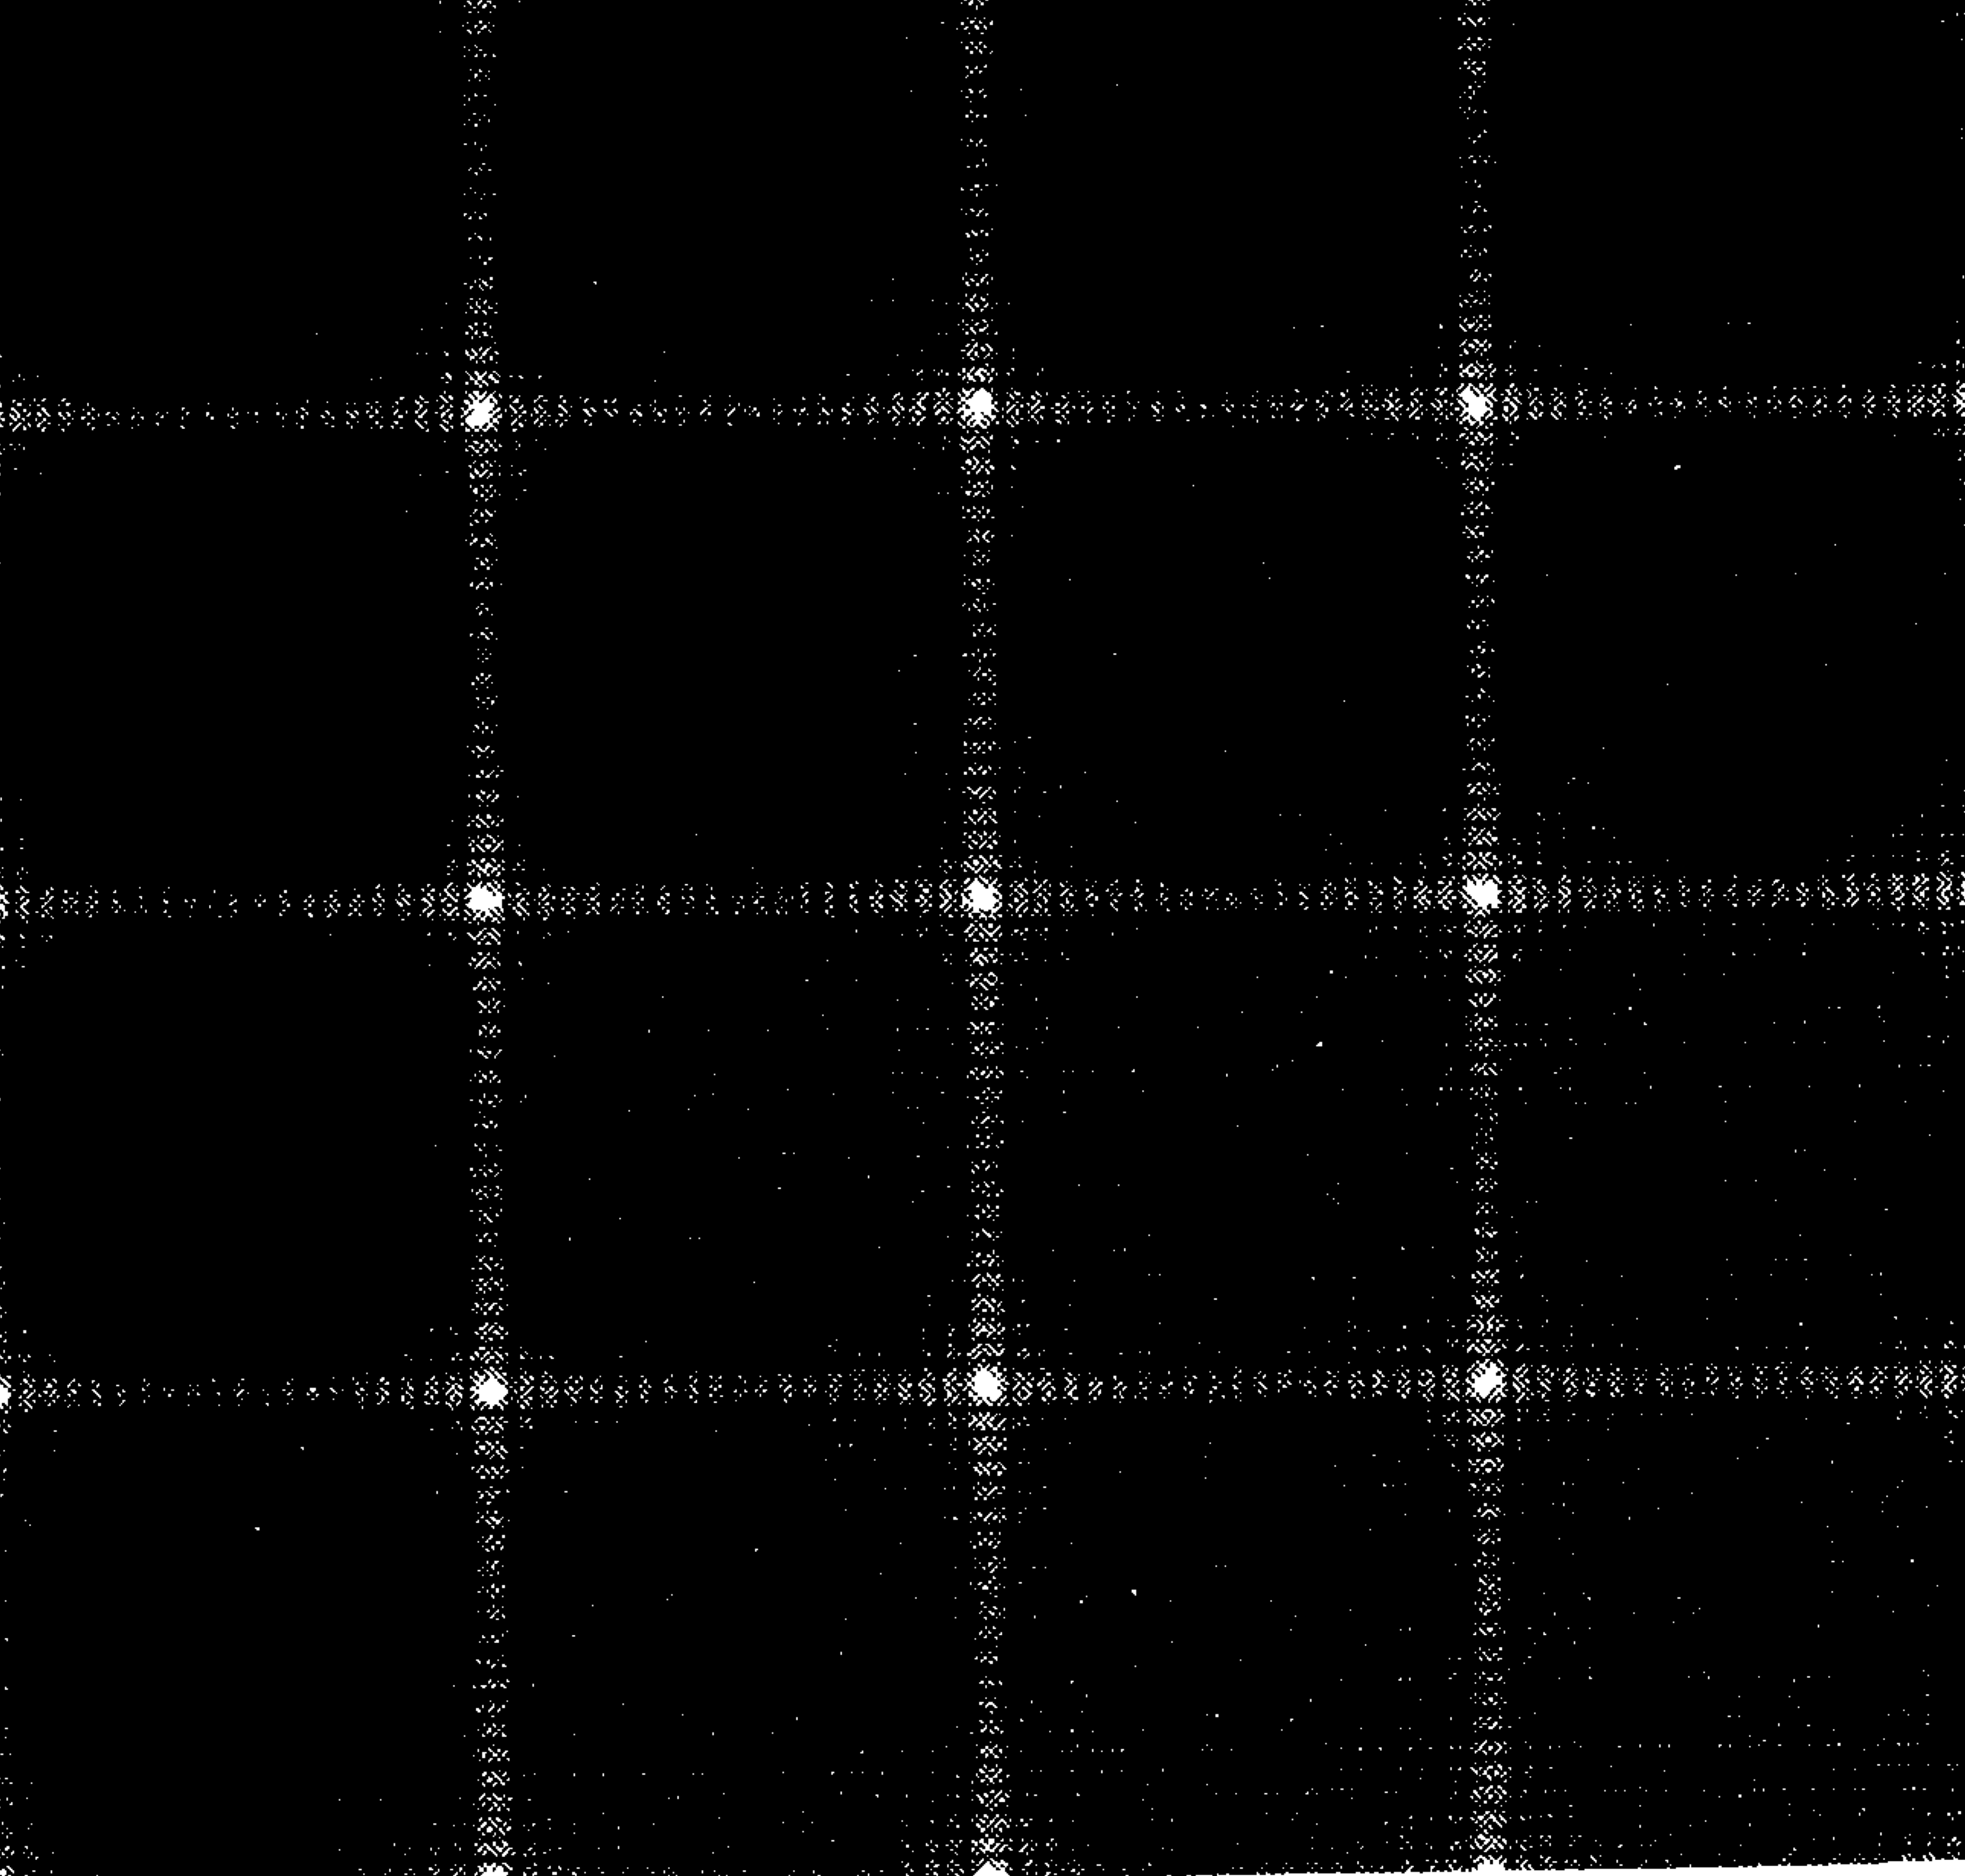
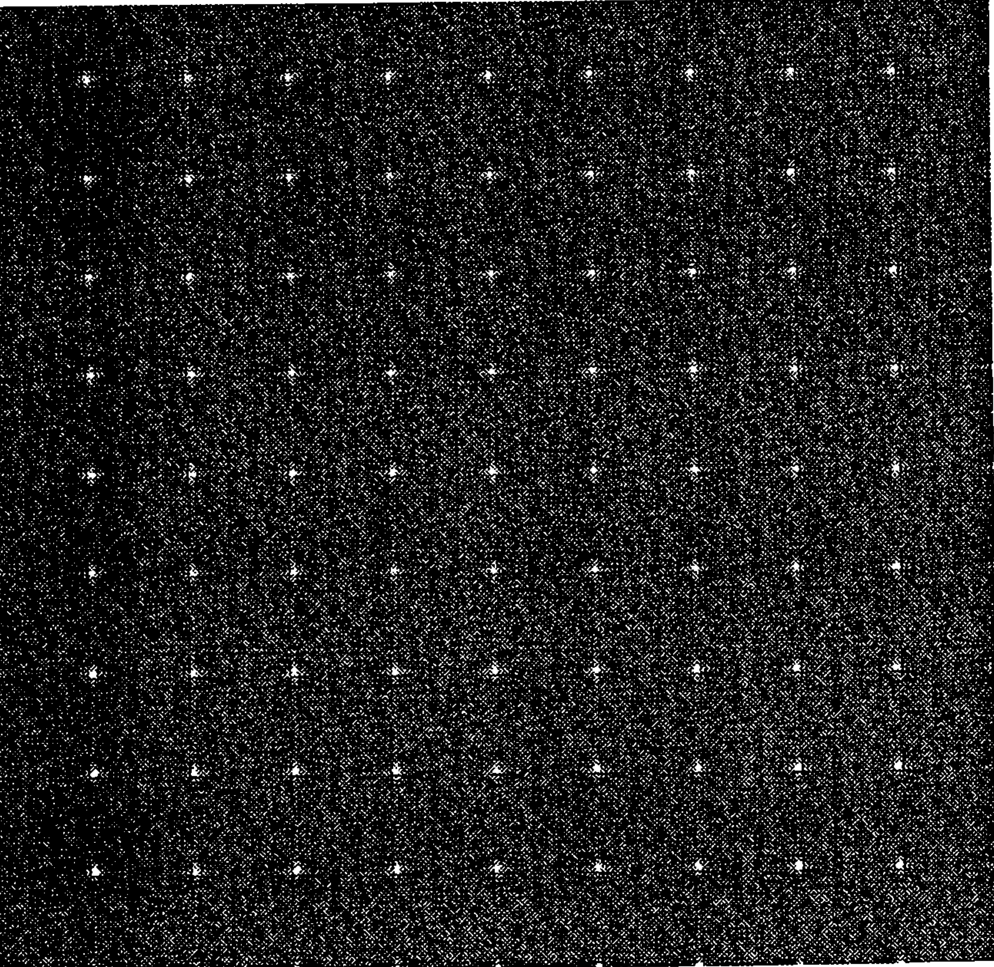
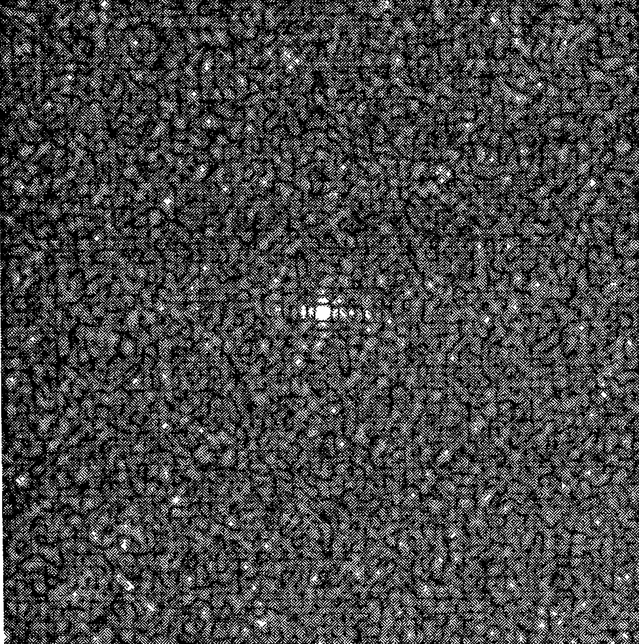
Paradigm Shift
In 1992 the definition of a crystal was changed by the International Union of Crystallography through the Ad Interim Commission on Aperiodic Crystals. A crystal was defined as “any solid having essentially discrete diffraction diagram”.
Credit: M.Senechal, “Quasicrystals and Geometry”

Slide 8
Counterexamples
Pinwheel Tiling
Credit: Baake and Grimm, Aperiodic Order: Volume 1 , A Mathematical Invitation 2013

Slide 9
Visible Points Lattice
Credit: Baake and Grimm, Aperiodic Order: Volume 1 , A Mathematical Invitation 2013

Slide 10
Modelling Periodic and Nonperiodic Crystals
Functions
Density functions describe a distribution of points in space and define its diffraction pattern.
Tilings
A finite set of prototiles corresponds to a finite number of atomic or molecular configurations of a physical crystal.

Slide 11
Modelling Periodic and Nonperiodic Crystals: Measures
The general framework of measures includes functions and tilings as special cases.
Almost periodic measures describe both periodic and nonperiodic distributions.
Diffraction pattern is completely determined by a well-defined measure.

Slide 12
What is a Crystal?
The definition of a crystal depends on the tools describing its structure.
In terms of measures, a mathematical crystal can be defined as a distribution of points with a unique autocorrelation measure containing a discrete component.

Slide 13
What is a Quasicrystal?
A quasicrystal is an abbreviation for a quasiperiodic crystal.
Quasiperiodicity and periodicity are special cases of almost periodicity.
An almost periodic point set is defined as a point set which distribution can be expanded as a superposition of a countable number of plane waves.
A point set is called quasiperiodic if there is a finite number of plane waves which define its distribution. Hence, all periodic point sets are quasiperiodic.
A crystal is called quasiperiodic if and only if its distribution is quasiperiodic.

Slide 14
Construction of Nonperiodic Crystals
No general procedure encompassing all distinct cases has been developed.
Known methods include the following:
Cut-and-project
Multigrid
Substitution
Matching rules

Slide 15
Further Research
Rigorous general systematic approach to the study of periodic and aperiodic structures is required.
The theory of matching rules should be rigorously developed, and the cut-and-project method should be generalised and formalised.
The inverse problem of homometry is important for the classification of nonperiodic structures.

Slide 16
Evaluation
Lack of mathematical maturity has delimited the use of available resources.
Research is largely based on reviews and discussions rather than proofs and arguments.
No exhaustive and rigorous treatment of the modelling techniques is given.

